Slide 1
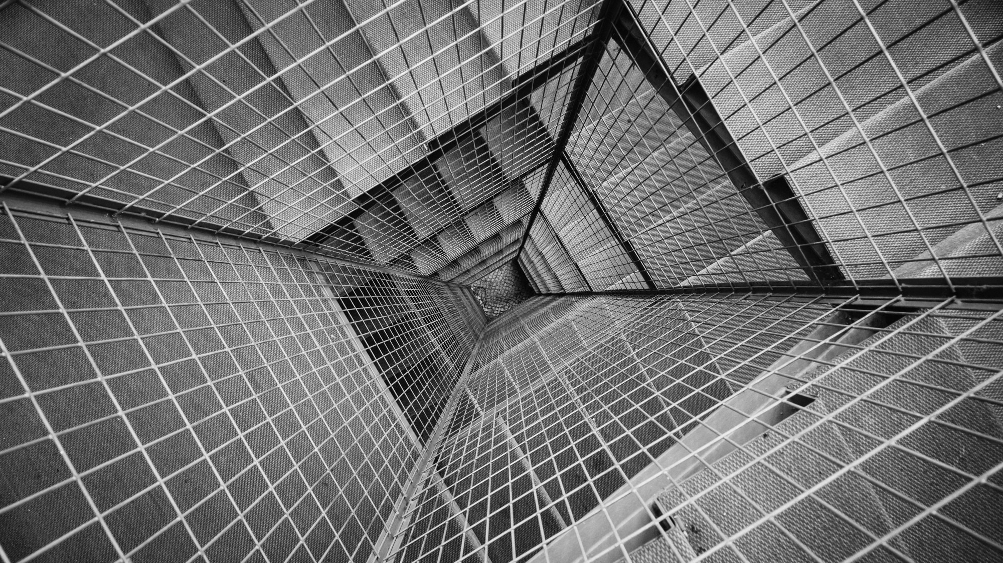
UNC Schedule
UNCW Capstone Project Fall 2018

Slide 2

Our Goal
Our goal is to create a hub for UNCW students to interact with a user interface that will display schedule permutations
Many students tend to spend copious amounts of time creating 4-5 schedules a semester to maybe not find the schedule they are looking for
In the end, our system should be able to display a student with an ideal schedule and displays course information

Slide 3
Target Audience
In the early days of development, our project was going to be created for every UNCW student that uses SeaNet to enroll in courses
After weeks of development, we decreased our scope to undergraduate UNCW students

Slide 4

Requirements
In order for our project to be a success we have outlined a few requirements that needed to be met. A few of these include:
Allowing a student to input four or more courses
Generate an optimized schedule within a reasonable amount of time.
Allow students to navigate the website stress free

Slide 5

Three Part Project Plan
Obtain Data
Manipulate Data
Present Data
Through this three step process plan, we would obtain the material and data to implement a front end application that will meet our requirements. Through these three steps of the process, there were many trials and tribulations that with more time could have been solved in a more appropriate manner.

Slide 6
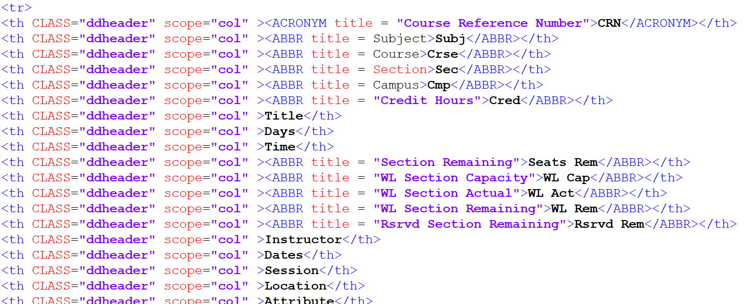
Implementation (Obtain Data)
The first step in our process plan was to obtain the data from the UNCW SeaNet website. This was accomplished through a series of web crawlers. Although it was not a simple implementation, we used a C# program to run a Selenium web driver. Selenium will connect to the path of the website and gather the HTML source code that was displayed on the page. Since SeaNet can not be accessed by a direct path, it was necessary to introduce button clicks in the Selenium code.
← This is an example of SeaNet source code

Slide 7
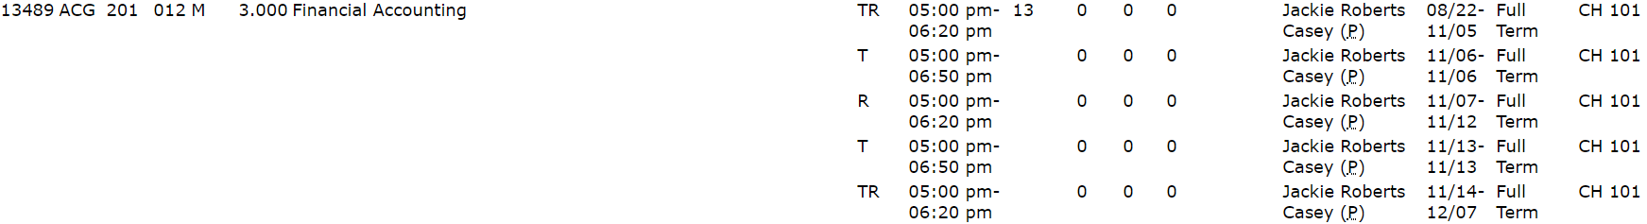
Implementation (Manipulate Data)
Manipulating the data was by far the most difficult part. Taking an HTML table row that does not have a CRN and associating it with the previous CRN found was the operation that had to be conducted.
By associating table rows with the last CRN found, we were able to concatenate the days and times together, separated by an *.
But, as we quickly found out, it is not simple to compare multiple concatenated strings. Thus came along the BitArray.
Days Concatenated As: TR*T*R*T*TR
Time Concatenated As: 05:00 pm-06:20 pm*05:00 pm-06:50 pm*05:00 pm-06:20 pm*05:00 pm-06:50 pm*05:00 pm-06:20 pm

Slide 8
BitArray’s
Days Concatenated As: TR
Time Concatenated As: 11:00 am-12:50 pm
Days and Time expressed as a BitArray: 000000000000000000000000000000001111000000000000000000000000000000000000000000001111000000000000000000000000000000000000000000000000000000000000000000000000000000000000
As defined by Emory University, a BitArray or BitSet is an array data structure that compactly stores bits.
In our case, we assumed that all courses in our course table was within the time constraint of 7:00 AM and 7:00 PM. This allowed us to create a 168 bit BitArray that could store our complex concatinated string.
Bit Layout:
168 Bits Total
24 Bits per 12 hours day
2 Bits per 30 minute interval

Slide 9
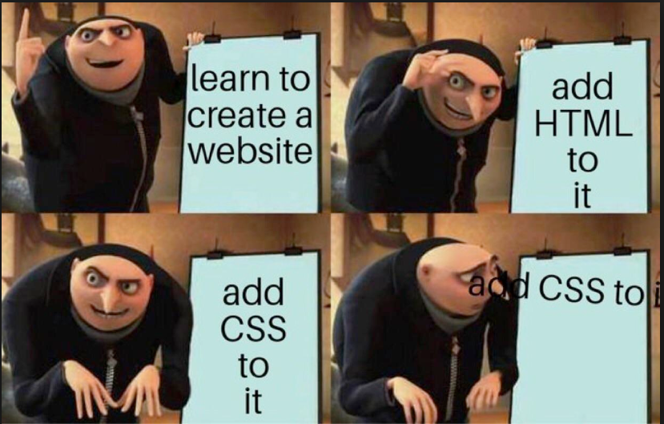
Implementation (Display Data)
This was a crucial part of our operation considering without a front end interface, no student will use our application
In order to display a schedule using a front end website, we had to use a variety of new technologies that enabled us to make dynamic updates to a static schedule template

Slide 10
List of Technologies Used
Development Environments: Visual Studio, PyCharm, Notepad++
Programming Languages: Python, C#, JavaScript, Jquery, Ajax, SQL*
Markup Languages and Other Technologies: HTML, CSS, BootStrap, Selenium, HTMLAgilityPack, CodyHouse

Slide 11
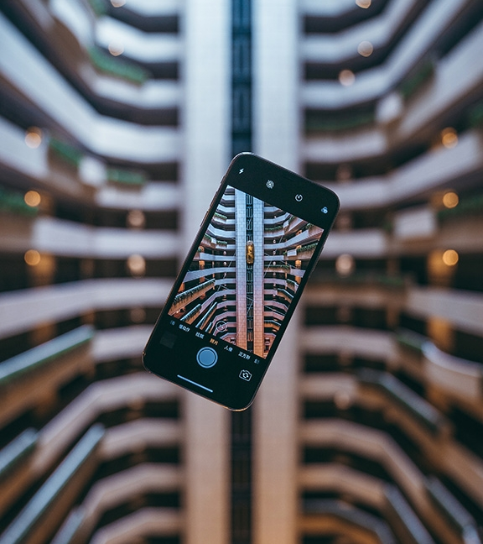
DEMO

Slide 12
Next Steps
As mentioned in the Demo, there are some portions of the project that were not able to be implemented due to time limitations. These include but are not limited to:
Work Schedule
Preferred Times
Preferred Days
User Accounts
Return Multiple Schedules to User
Update Database Constantly
Create Mobile Application

Slide 13
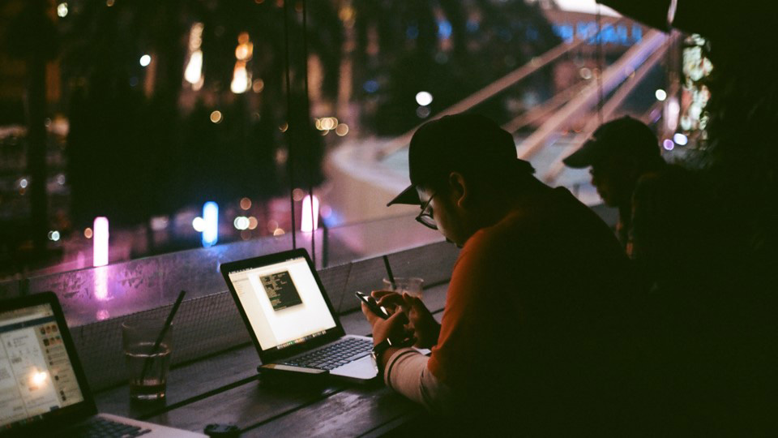
Large Picture Slide
Questions?

Slide 14
THANK YOU

